Slide 1


STC TV Data Analysis Project
Created by Shareef Huzaifa
A comprehensive Python-based analysis of viewer behavior and preferences on STC TV platform. This project showcases three key components through advanced data science techniques.
Completed June 2025

Slide 2


Project Overview
1M+
3
Records Analyzed
Core Components
Viewing activity data from STC TV users
Watch behavior, demand forecasting, recommendation system
5
Technologies
Python, Pandas, Matplotlib, Scikit-learn, plotly
The project involved rigorous data cleaning, exploratory analysis, modeling, and visualization to improve user experience and engagement.

Slide 3



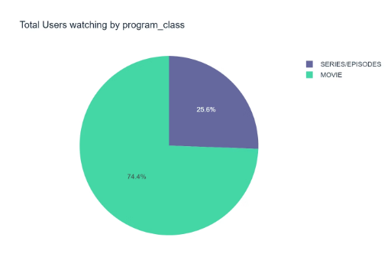
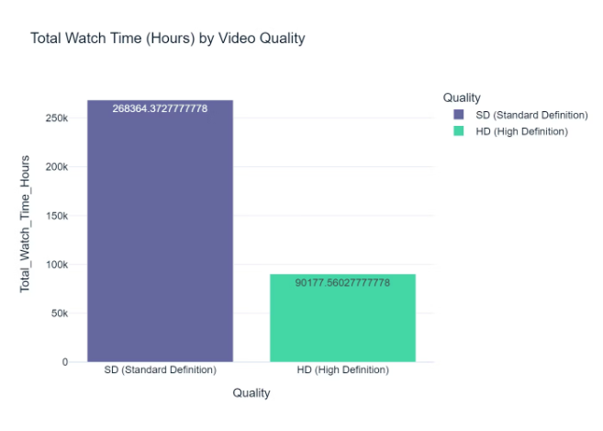
Watch Behavior Analysis
SD Users
HD Users
Top Content
Contribute majority of view time despite smaller numbers
More numerous but watch for shorter durations
"The Mermaid Princess" and "Moana" lead in viewership
Understanding these patterns reveals opportunities to optimize content delivery across different user segments.

Slide 4



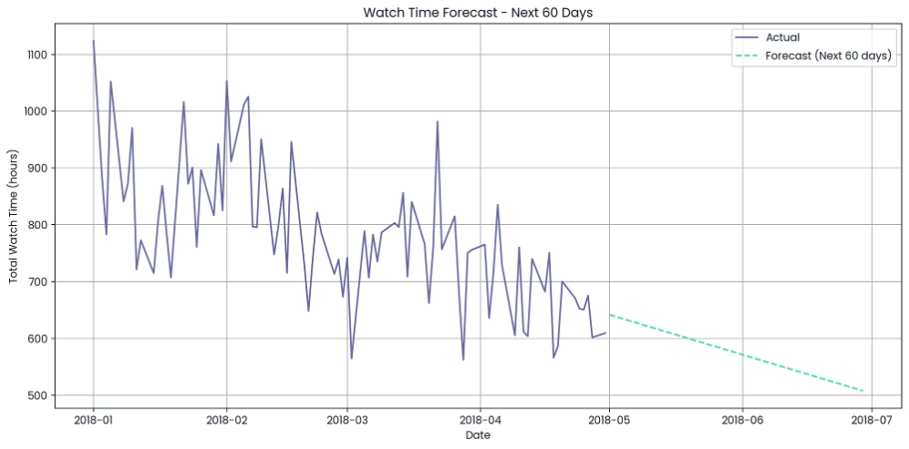
Demand Forecasting
Data Collection
Linear Regression
Expected Decline
Gathering historical viewing patterns
A simple linear regression model was used to forecast daily watch time for the next 2 months.
The trend shows a gradual decline, suggesting a possible seasonal drop in viewer engagement.
This forecast helps infrastructure planning and aligns marketing efforts during predicted low demand periods.

Slide 5



Recommendation System
The system uses collaborative filtering with cosine similarity. It offers personalized suggestions based on similar users' viewing habits.
A user-based collaborative filtering model was built using rating data and cosine similarity.
The model generates personalized recommendations by identifying users with similar viewing habits.
For users who watched "Moana", the system recommended family-friendly titles like Surf's Up and The Boss Baby, showing strong content alignment.
Program
Similarity Score
Surf's Up : WaveMania
2.000000
The Birth of a Nation
2.000000
Alien: Covenant
1.989130
The Boss Baby
1.333333
100 treets
1.000000

Slide 6
Insights Summary & Recommendations for STC TV
Key Insights
Strategic Recommendations
SD viewers drive more total watch time despite smaller numbers
Optimize streaming defaults based on device quality patterns
Watch hours trending downward, suggesting seasonal engagement dip
Schedule content releases around predicted demand cycles
User-based recommendations show strong relevance for family content
Enhance recommender system by incorporating content metadata
My analysis reveals clear opportunities to improve user experience while optimizing platform resources. Implementing these recommendations could significantly boost engagement and retention.

Slide 7




Let's Connect
GitHub
LinkedIn
Find the full project at github.com/shareef99997
Connect professionally at linkedin.com/in/shareef-ali
Personal Website
Access All my projects and Expertise Through Shareef Al Website

